Slide 1

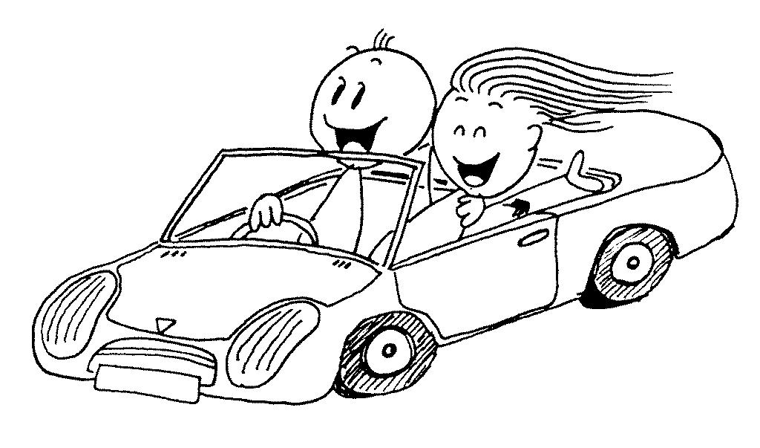
DRIVE
Curriculum
CHINA presentations

Slide 2

You will be spending the day working with a partner to create a presentation about China.
This will be presented in period six to a group of your classmates.
It can last no longer than ten minutes including time for answering questions.
You may choose to cover all aspects of your work on China or cover one particular area in more detail.
Your presentation will be marked against success criteria and credit will also be given for how well you work as a pair, how you manage your time and how well you communicate your presentation.
You will need to leave time to practice your presentation before period 6.

Slide 3
Success Criteria for presentation
Set purpose – ensure your presentation meets the purpose
of showcasing your Drive CHINA learning – this could look
at everything you have covered about China or you could
focus on one particular area and go into more detail
Set audience – you will be presenting to your classmates at
the end of the day so make sure it is suitable for a key stage
three student.
Consider:
The language used
The images chosen
The appeal of the colour
scheme
The fonts chosen
You must have:
At least ten slides
A suitable image on each slide
At least one image should be primary (something
you have created or a photograph you have taken)
Suitable animation on each slide
Suitable transitions between slides
To gain extra credit you could also include:
At least one sound clip
At least one video clip
Hyperlinks and a contents page

Slide 4

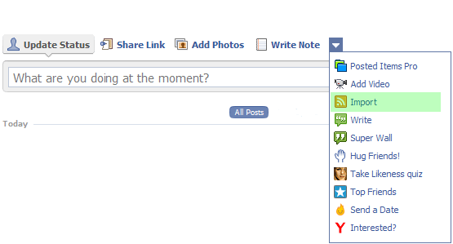
drivebook
Wall
What have you enjoyed the most about today?
Which of your learning skills have you used the most today?
How did your activities today help you develop these skills?
Which learning skills do you need to improve the most?
What could you do in your next lessons to help you improve these skills?
Reflection
Answer these questions on paper to keep in your Drive folder

